Slide 1


Slide 2

Day 6: Agenda
Introduction to Clustering
K-Means Clustering
K-Means Algorithm
Choosing the Number of Clusters (K)
Introduction to Hierarchical Clustering
Agglomerative Hierarchical Clustering
Hands-On Practical Example: Customer Segmentation

Slide 3
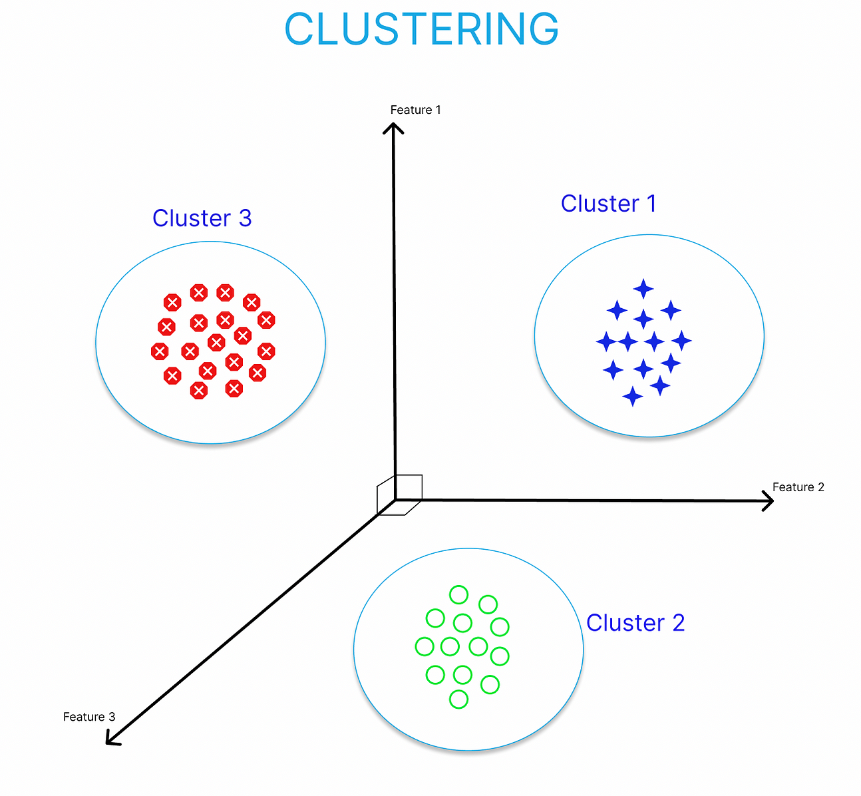
What is Clustering?
Definition: Clustering is the process of grouping similar data points together based on their features.
Applications: Clustering is used for customer segmentation, image analysis, anomaly detection, and more.
Importance: It reveals hidden patterns, simplifies complex data, aids decision-making, and enhances data visualization.

Slide 4
Types of Clustering
Partitioning Clustering:
In partitioning clustering, data points are divided into non-overlapping clusters.
Common algorithms include K-Means and PAM (Partitioning Around Medoids).
It is efficient and scales well to large datasets.
Hierarchical Clustering:
Hierarchical clustering builds a hierarchy of clusters, represented as a tree-like structure or dendrogram.
Agglomerative and divisive methods are commonly used.
Useful for exploring data at different granularity levels.

Slide 5
K-Means Clustering
K-Means clustering is a partitioning clustering technique that groups data into K distinct, non-overlapping clusters. It aims to minimize the distance between data points within the same cluster and maximize the distance between different clusters.
Use Cases and Examples:
Customer Segmentation: Retailers use K-Means to group customers based on purchasing behavior.
Image Compression: K-Means reduces the number of colors in an image to compress it.
Anomaly Detection: It helps identify unusual patterns in data, such as fraudulent transactions in finance.
K-Means is a widely used and efficient clustering method with applications in various fields.

Slide 6
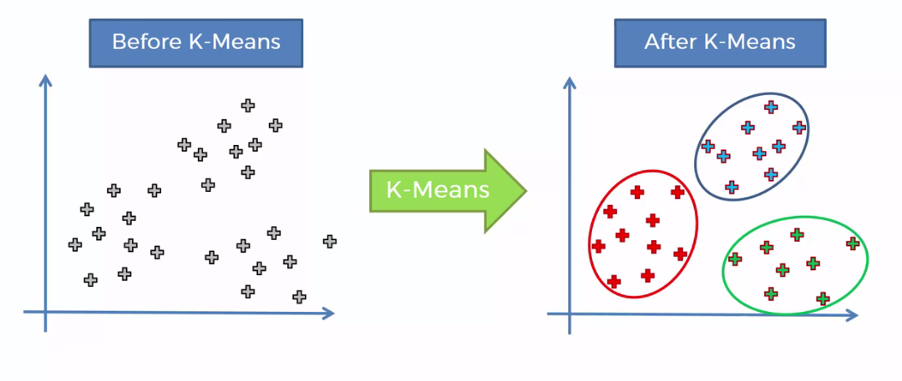
K-Means Clustering

Slide 7
K-Means Algorithm
Initialization: Start with K initial cluster centroids.​
Assignment Phase: Assign each data point to the nearest centroid based on distance.​
Update Phase: Recalculate centroids as the mean of data points in each cluster.​
Iteration: Repeated assignment and update phases until convergence.​
Result: Final cluster assignments represent the solution.

Slide 8
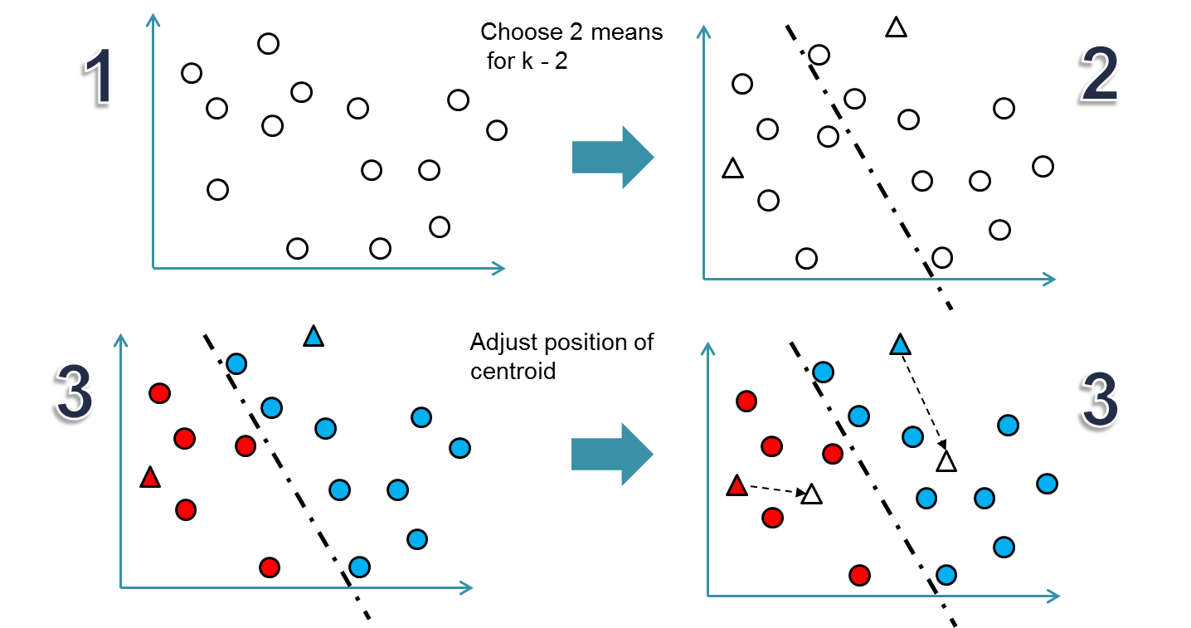
K-Means Algorithm

Slide 9
Methods of K Selection
Elbow Method:
The Elbow Method helps choose the optimal number of clusters (K) in K-Means.
Usage: It involves running K-Means with different K values and plotting the sum of squared distances (inertia) for each K. The "elbow" point on the graph, where inertia starts to level off, is often the optimal K.
Silhouette Score:
Silhouette Score evaluates the quality of clusters.
Usage: It measures how similar data points are to their own cluster (cohesion) compared to other clusters (separation). A higher Silhouette Score indicates better clustering. It's calculated for various K values, and the K with the highest score is selected as optimal.

Slide 10
Question
Using the "customer_segmentation.csv" dataset, find the optimal number of clusters (K) for K-Means clustering. Apply the Elbow Method and Silhouette Score to determine K.
Notes:
Note:- Use Jupyter file for this question - Elbow Method & Silhouette Score for K selection - Customer Segmentation Dataset.ipynb

Slide 11
Hierarchical Clustering
Hierarchical clustering builds a cluster hierarchy, starting with individual data points and progressively merging them based on similarity.
Advantages:
Provides a visual hierarchy (dendrogram).
No need to specify the number of clusters in advance.
Use Cases:
Biology (phylogenetics).
Document clustering.
Image segmentation.
Understanding hierarchical relationships in data.

Slide 12
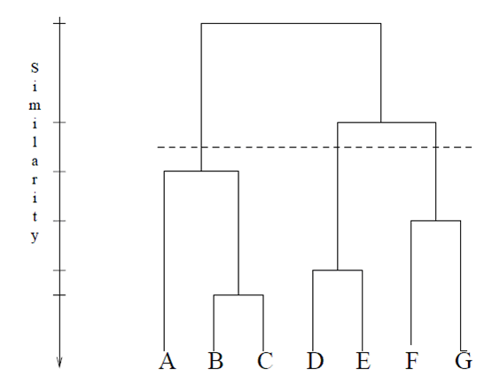
Hierarchical Clustering

Slide 13
Agglomerative Hierarchical Clustering
Agglomerative hierarchical clustering is a "bottom-up" approach. It starts with each data point as an individual cluster and iteratively merges the closest clusters until a single cluster contains all data points.
Hierarchy Building:
Start with each data point as a separate cluster.
Identify the two closest clusters and merge them.
Repeat step 2 until all data points are in a single cluster or a predefined stopping criterion is met.
The hierarchy is represented as a dendrogram, showing the sequence of merges.
Agglomerative hierarchical clustering progressively combines data points into larger clusters based on their proximity, leading to a hierarchical structure.

Slide 14
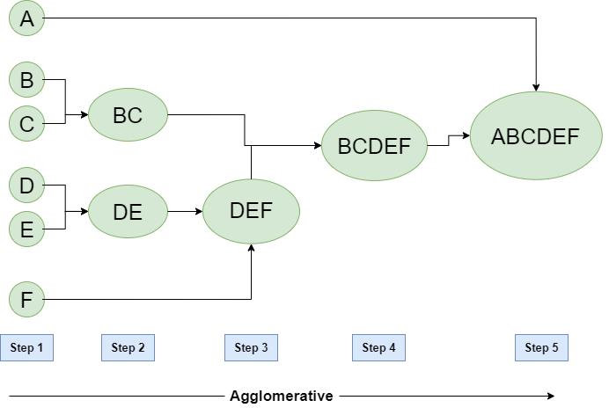
Agglomerative Hierarchical Clustering

Slide 15
Agglomerative Clustering Steps
Initialization: Begin with each data point as an individual cluster.
Pairwise Distance: Calculate pairwise distances (e.g., Euclidean) between all clusters.
Cluster Merge: Merge the two closest clusters based on linkage criteria (e.g., single, complete, or average linkage).
Distance Update: Recalculate distances between the merged cluster and other clusters.
Repeat: Repeat steps 2 to 4 until a single cluster containing all data points is formed or a stopping criterion is met.

Slide 16
Agglomerative Clustering Steps
Linkage Criteria:
Single Linkage: The distance between two clusters is the minimum distance between any two data points, one from each cluster.
Complete Linkage: The distance between two clusters is the maximum distance between any two data points, one from each cluster.
Average Linkage: The distance between two clusters is the average distance between all data point pairs, one from each cluster.

Slide 17
Dendrogram
A dendrogram is a tree-like diagram in hierarchical clustering, displaying the sequence of cluster merges.
Interpretation and Use:
Visualizes hierarchical cluster structure.
Helps determine optimal cluster granularity.
Aids in understanding data point relationships and similarities.

Slide 18
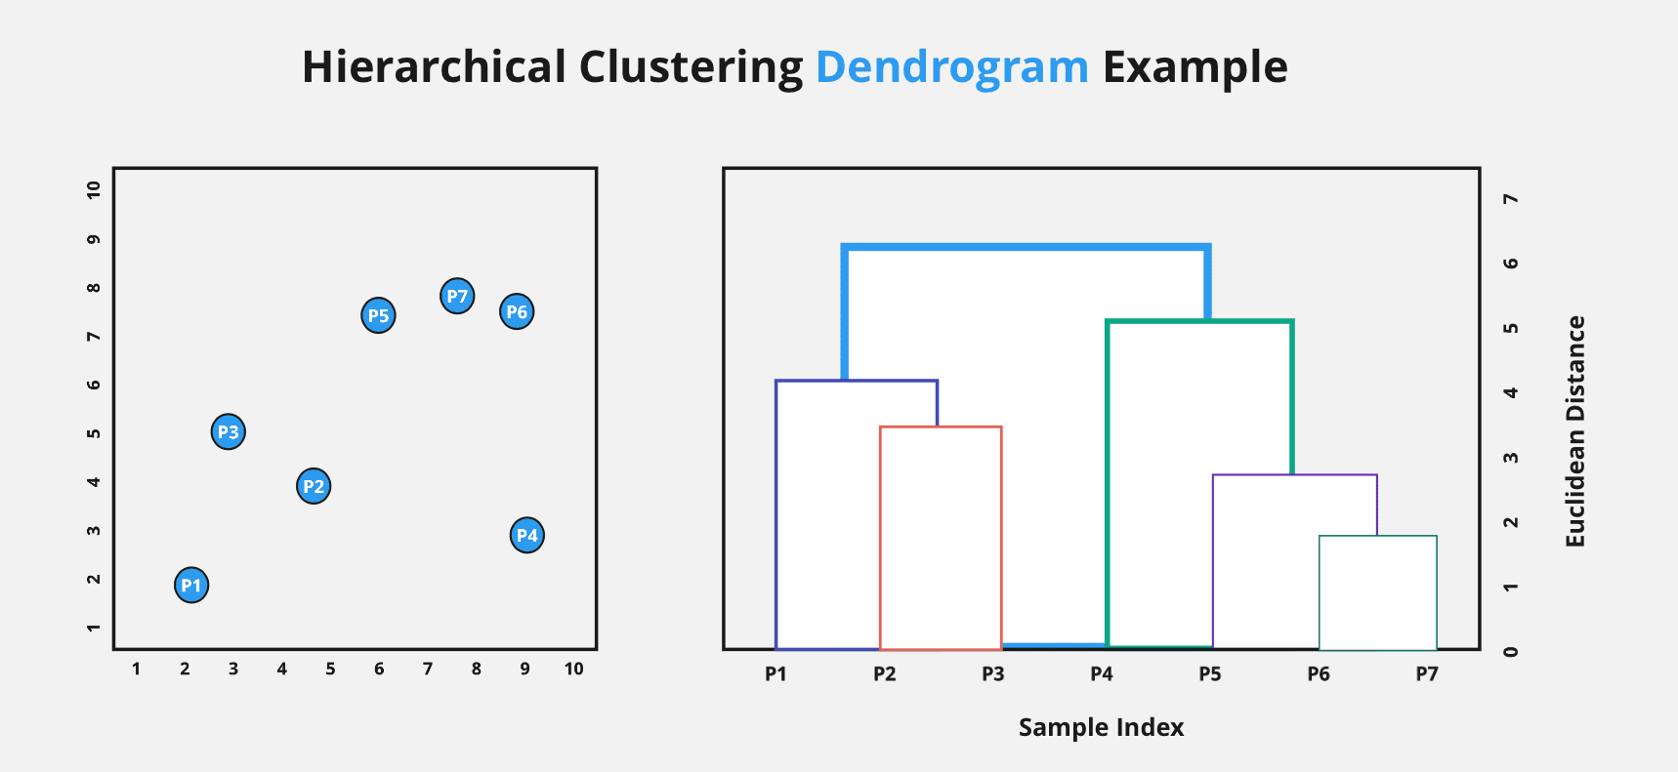
Dendrogram

Slide 19
Question
Write a Python code to perform K-means clustering on the provided bank transaction dataset, using the Elbow Method to determine the optimal number of clusters
Notes:
Note:- Use Jupyter file for this question - K-Means Clustering - Bank Transaction Dataset.ipynb

Slide 20
Questions ?

Slide 21
Thank You !

